Slide 1
Teaching Children
Self-Regulation of Anger:
A Neurodevelopmental Systems Approach
CW Austin Learning Disabilities Conference
February 28, 2026
Randall L. Lemoine, Ph.D.
Psychologist in Private Practice
7913 Wrenwood Blvd. Suite A , BRLA 70809
225-383-9808
www.RandallLemoinePhD.com
Rev. 02.15.26

Slide 2
Our Agenda
Why Teach Self-Regulation of Anger?
All about Anger and its Expression
What is Self-Regulation of Anger (SR/A) ?
A Neurodevelopmental-Systems Approach
SR/A Teaching Tools, Techniques & Tips
  My Calming Procedure & Place; Roar Ratings
  5-Steps to Taming Temper During/After Episodes
  Positive Communication & Conflict Resolution
Notes:
SR/A Teaching Tools & Strategies

Slide 3
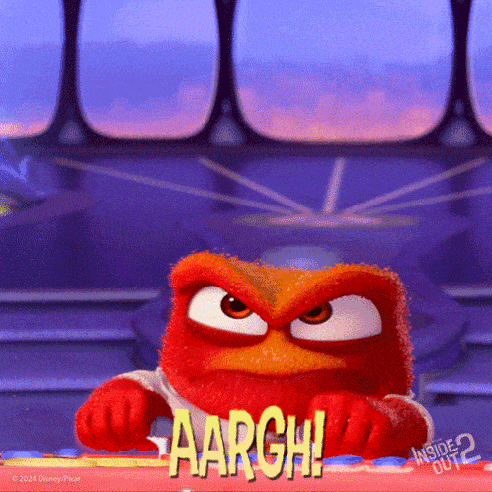
Had experience with this guy?

Slide 4
Why Teach Children SR/A?
SR/A is a critical & core life skill
Anger is a public epidemic & on is the rise
Anger is often a core feature of many neurodevelopmental disorders:
  ASD; ADHD; ODD; IED; & DMDD
We know a lot about anger & self-regulation skills to teach it effectively! But often don’t.

Slide 5
Teaching SR/A Is Not New:
 | Major Modern Times Milestones
1960’s | Cognitive (Behavioral )Therapy (CBT) introduced - Aaron Beck, M.D. Rational Emotive Behavior Therapy (REBT) - Abert Ellis, Ph.D.
1970’s | Anger Management Training – Raymond Novaco, Ph.D. Sensory Integration and the Child - D.A. Jean Ayers, Ph.D., O.T.
1980’s | Anger Management Programs – upsurge of programs & applications Positive Discipline (1981) – Jane Nelson, Ed.D.
1990’s | The Alert Program -Mary Sue Williams & Sherry Schellenberger, OTR/L Social-Emotional Learning (SEL), CASEL – upsurge of programs
2000’s+ | The Incredible 5-Point Scale (2003, 2022) – Keri Dunn Buron, M.Ed. Zones of Regulation (2011,2024) – Leah Kuypers, M.Ed., OTR/L Positive Discipline Programs proliferate e.g., Conscious Discipline - Becky Bailey, Ph.D.; No Drama Discipline; Dan Siegel, M.D. & Tina Bryson, Ph.D. And Many More

Slide 6
About Anger & its Expression
A natural emotion with an adaptive purpose
Anger is a stress response – Fight/Flight/Freeze continuum
Anger is energy – an e-motion (anger arousal stimulates action)
Anger is a psycho-physiological experience
Anger covers many other unpleasant feelings (a “secondary emotion”)

Slide 7
About Anger & its Expression
Anger ≠ angry misbehaviors ≠ a character flaw
Anger may be expressed, suppressed, or vented ; suppression/venting ≠ self-regulation
Unexpressed anger has mental/health impacts
Anger can be as addictive as a drug
SR/A is typically “taught” thru punishment for angry misbehaviors, resulting in suppression or venting, which often impedes learning SR/A

Slide 8
What is Self-Regulation of Anger?
A Google AI overview statement:
  "Self-regulation of anger" in children refers to their ability to recognize and manage their own angry feelings, allowing them to respond appropriately to frustrating situations without outbursts or aggressive behavior, essentially calming themselves down when they start to feel angry."

Slide 9
What is a Neuro-developmental Systems Approach to Teaching SR/A?
NEURO
  The human brain & nervous system are the source of all thinking, feeling, behaving & relating
  The limbic system & pre-frontal cortex are critical to SR/A
DEVELOPMENTAL
  Orderly progression over one’s lifespan from an immature to mature, adult state; Thru stages & critical periods; Other-regulation > Co-regulation > Self-regulation
  The brain & nervous system development follow an orderly progression; 90% brain developed by age 6! Yikes! Neural “pruning” & new growth happen during tween/teen years
  Psychosocial systems develop concurrently w/ neuro ones; Nature (genetic) x Nurture interact each step of the way

Slide 10
What is a Neuro-developmental Systems Approach? cont’d
SYSTEMS
  System = A network of interacting components that operate together to accomplish a functional goal
  Nervous system components: CNS & ANS; Sympathetic & parasympathetic; Exteroceptive & interoceptive, etc.
  Psychosocial systems
    The Caregiver-Child Interactional System primary to SR/A
    SR/A skills develop through a Teaching-Learning System
  SR/A: a neurodevelopmental skill set best taught from a neurodevelopmental systems mindset & approach!

Slide 11
SR/A & the Developing Brain
The Emotion Center (Limbic System)
The Executive Center (Pre-Frontal Cortex)
Primitive, survival-oriented, deep structures
Center for e-motion
Immediate/ Short-term
The Alarm Center: Fight/Flight/Freeze
The Attachment Center
The Reward Center
The Brain’s DVR - SEL
Most recent, advanced lobe of the human brain
Center for self-discipline
Intermediate/ Future goal
“CEO”/ “Orchestra Conductor” of the brain
Not fully mature until mid-20s!
  ADHD brain – 3 -5 year lag

Slide 12


The Anger Cycle {habit}
Resolution
A. Activating event (Trigger)
ANGER
C. Consequence
B. Reaction/
Response

Slide 13

Caregiver – Child Interaction:
The Classroom of Self-Regulation Learning
Influences:
Neurodev. Status
Temperament
Sensory Processing
Physiological state
Stressors
Relationship
Disciplinary approach
Caregiver Child
SR/A is as much “caught” as it is “taught”

Slide 14
Positive Discipline Promotes SR/A:
What is Positive Discipline?
It is NOT Negative
It is NOT Permissive
Yell/ Scream/ Threaten
Scold/ Reprimand/ Criticize
Lecture/ Nag
Shame/ Blame/ Defame (i.e., name-calling)
Humiliate/ Berate/ Belittle
Spank/ Slap/ Pinch…
Etc.
What about - Time-out? Detention? Behavior Clip Charts?
Being overly lenient, indulgent, laissez-faire
Timid about applying negative consequences
Having few rules, expectations, demands
Giving-in to child’s wishes, aka submissive
Pleading/ Placating
Pampering/ Spoiling
Etc.

Slide 15
What is Positive Discipline?
It is FIRM + KIND
Brings together these 2 essential dimensions of discipline (the discipline “sweet spot”)
  Firm = Clear & consistent limits; Persistent follow-thru plus
  Kind = Caring, compassionate, respectful, nurturing
  E.g., “Honey, I love you, AND the answer is still no.”
Contrasts w/ traditional discipline approaches that often impede SR/A learning
  Firm, but not Kind = Autocratic & coercive (like acting like a drill sergeant or prosecuting attorney) provokes anger
  Kind, but not Firm = Permissive & indulgent (like being a doormat, or pushover) often rewards anger episodes
  Inconsistent or vacillating (over time or between caregivers)

Slide 16
Positive Discipline Mindset vs. Traditional Discipline Mindset
Traditional Discipline
Positive Discipline
Misbehavior major focus
Control/thru Submission
Threaten/Punishment
Episodic (@misbehaviors)
Reactive/ Immediate goal
Overpower
Extrinsic Motivation
Behaving Well is focus
Skills/thru Collaboration
Guide/ Nurture/ Teach
Continuous process
Responsive/ Long-term
Empower
Intrinsic Motivation

Slide 17
Positive Discipline: 4 Principles
Person-Centered
  Child ≠ Misbehavior ≠ Anger; Child is not a miniature adult; Misbehaviors are viewed as “mistaken choices,” not willfulness
Relationship-Based
  Caregiver-child relationship > any episode of misbehavior; Each caregiver-child interaction either ⇑ or ⇓ the relationship; maintains a mutual respect balance of dignity and worth
Skill-Oriented
  Discipline = teaching/learning process; Episodes of behavior = “teachable movements;” Misbehavior communicates a lagging skill, rather than character flaw (irresponsible, willful, not care)
Systematically Applied
  Purposeful; Consistent; w/ Fidelity; Adaptive, not rigid

Slide 18
Teaching Self-Regulation of Anger:
Tools, Techniques, & Tips (at last!)
My Calming Procedure
My “Roar” Rating ( “Temper the Tiger” Training)
My Calming Place & “Take5”
Using Games to Promote SR/A
5-Steps to Taming Temper During & After Episodes
Positive Communication & Conflict Resolution Skills
Notes:
SR/A Teaching Tools & Strategies

Slide 19
My Calming Procedure:
Calm Body Skills
Calm Breathing (aka diaphragmic or belly breathing)
    Inhale through the nose, exhale through the mouth, slowly, deeply, smoothly; w/relaxed shoulders & jaw
    e.g., 4-square breathing; star breathing, etc.
Tense and Release
    Progressively tense then relax body parts from head to toe (or visa versa) to “let it go” (Elsa got it right!)
Body Scan
    Mentally scan & progressively relax body parts head to toe, similar to Tense & Release but only mentally
Notes:
SR/A Teaching Tools & Strategies

Slide 20
My Calming Procedure:
Calm Mind Skills
Positive Self-talk & Affirmations
    Help child to be aware of their automatic negative self-talk that can often increase their anger (e.g., ..)
    Coach child into using positive, calming self-talk & affirmations that w/ practice decrease anger (e.g.,…)
Tranquil Imagery
    Visualize a calm place & state of mind & body (e.g.,)
    Coach child to use calm body skills and to engage their senses in the scene to experience “being there”
Notes:
SR/A Teaching Tools & Strategies

Slide 21






My Calming Procedure
I Close My Eyes
2. I Smile & Sparkle
3. I Breathe-In (slow & deep)
  I Breathe-Out (slow & easy)
4. I Imagine Myself Calm
5. I Say to Myself “I’m Calm”
I am calm!
Notes:
SR/A Teaching Tools & Strategies

Slide 22
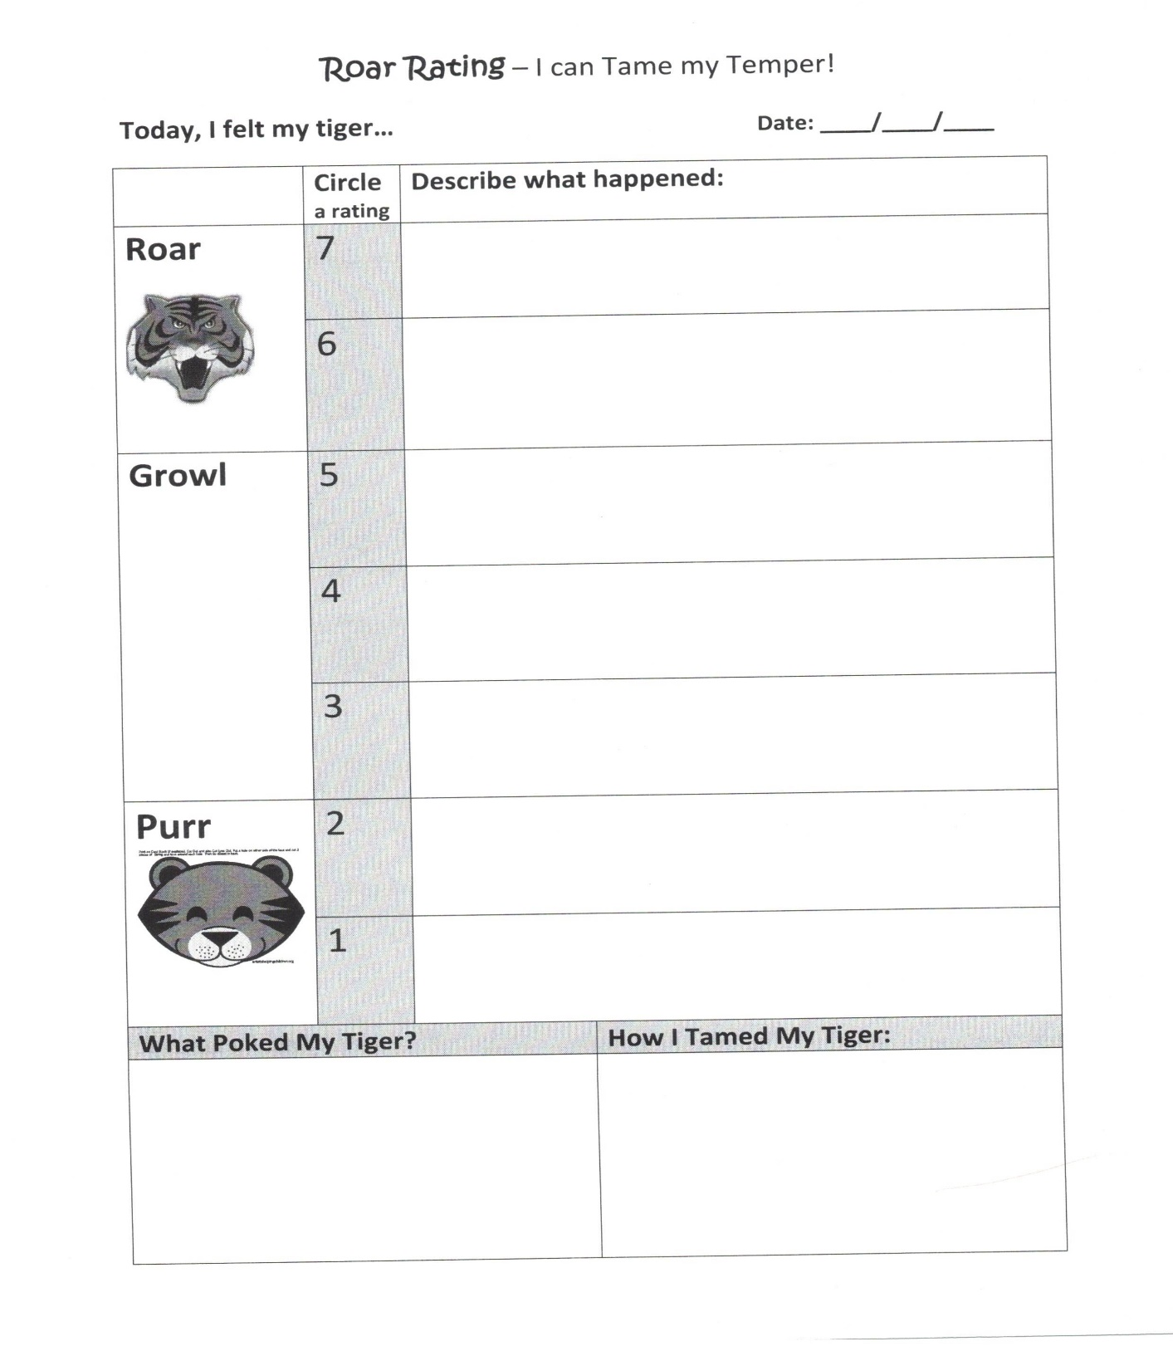

Slide 23
My Calming Place & “Take5”
An inviting, comfortable place where the child can actively remove her/himself from the anger arousal scene & actively engage/learn self-calming practices
Pre-equipped with a soft cushion; a calming procedure graphic &/or books; stuffed animal (Temper the Tiger); sand timer; Personalized by the child, but keep it simple
This is not a Time Out: Invited use, not demanded use; Also, not demanding: “Go to your room and cool down!”
Often used in conjunction w/ Take5: a mutually agreed upon 5-min “break” from the anger arousal moment & place, plus the expectation of returning afterwards w/ a calmer mindset, to seek solutions together w/ caregiver - maybe even offering apologies & forgiveness, etc.
Notes:
SR/A Teaching Tools & Strategies

Slide 24
Using Games to Teach SR/A
Children’s games can be used to teach & promote SR/A in a calm, focused, natural, & playful way
  E.g., Red Light/Green Light; “Mother, May I;” Simon Says; & Board Games, such as “Chutes & Ladders;” “Sorry”…
  Games provide excellent opportunity to teach many important SR/A subskills, such as: Rule-following; turn-taking; patience and frustration tolerance; team work, etc.
  Role-playing games (“I’ll be you, and you be me”) also used
  Note: Have a protocol/script in mind re: how best to respond to episodes of anger & opportunities for praise & encouragement when the child demonstrates good SR/A
Notes:
SR/A Teaching Tools & Strategies

Slide 25
5-Steps to Taming Temper During & After Episodes
Remain Calm, Connected & Correctional
Empathize & respond in a non-judgmental, validating, empowering manner
Guide & encourage use of a pre-planned self-regulation process
Follow-up with skill learning soon afterwards
Praise & affirm your child (& yourself) for good efforts and accomplishments
Notes:
SR/A Teaching Tools & Strategies

Slide 26
1. Remain Calm, Connected, & Correctional
Caregiver’s self-regulation of own anger is Job#1. Model calm to teach calm. (co-regulation!)
Press “Pause for P.E.A.C.E;” then “slo-mo”
Use your own calm body & calm mind skills
Do a mutual Take5 if anger continues to rise
Keep a correctional mindset, not punitive one: Remember this is a “teachable moment!”
Praise & affirm your child (& yourself) for good efforts and accomplishments of this 1st step!
Notes:
SR/A Teaching Tools & Strategies

Slide 27
2. Empathize & Respond in a Validating & Empowering Way
Empathy & compassion are stronger than anger; Strive to be caring, compassionate, & curious in the moment, rather than critical, accusatory, & coercive
Momentarily assume the child’s perspective (how s/he sees it), & temporarily suspend your own
Acknowledge & validate the mutual anger in the moment, without accepting the misbehavior
Help the child feel heard, felt, understood, & safe
Curious: Wonder & inquire about what is the child’s underlying threat or frustrated need; Reflect upon what skills need to be taught & empower a change
Notes:
SR/A Teaching Tools & Strategies

Slide 28
3. Guide & Encourage Use of a Planned Self-Regulation Process
Meet the child where s/he is & guide SR/A skill
Invite & encourage the child to use a calming procedure; help distract the focus off the anger
At the right moment, encourage use of My Calming Procedure – but don’t force it
Encourage mutual use of Take5 as needed & My Calming Place if anger is on the rise
Praise, encourage & affirm your child (& yourself) for good efforts & accomplishments
Notes:
SR/A Teaching Tools & Strategies

Slide 29
4. Follow-up with SR/A Skill Learning soon after the Episode
Once the episode has subsided, use the Roar Rating tool to identify the intensity of anger, the triggers, the self-regulation skills the child used, & what can be done next time to improve
This as the opportunity to further teach & “tweek” SR/A skills (“temper taming talks”)
Keep the focus on breaking/replacing the cycle
Model mutual respect: Apologies; forgiveness?
Plan for a Check-in (AM)/ Check-out (PM) time
Notes:
SR/A Teaching Tools & Strategies

Slide 30
5. Celebrate Good Efforts & Accomplishments Together!
Acknowledge that this is hard work and takes time, energy, patience, and dedication
Acknowledge the challenges as they arise as opportunities for learning and for creating more celebrations! (a growth mindset!)
Notes:
SR/A Teaching Tools & Strategies

Slide 31
Positive Communication & Conflict Resolution Skills
Seek first to understand, then to be understood
Maintain a mutual respect balance, between caregiver and child
Attack the issue/conflict, not the person
Notes:
SR/A Teaching Tools & Strategies

Slide 32
1. Seek first to understand, then to be understood
Help the child feel heard by seeking first to understand their point of view
Set your own viewpoint aside for a while (“Please help me to understand what is frustrating you right now”)
Listen more than speak (God gave us 2 ears & 1 mouth for a reason!)
Wait patiently for the child to finish before speaking
Notes:
SR/A Teaching Tools & Strategies

Slide 33
2. Maintain a mutual respect balance
Use respectful language, tone, & posture – peaceful, caring vs. threatening, demanding
Use “I messages” & Avoid “U messages” (“I feel angry when you…because…please…”)
Keep the focus on finding a Win-Win solution rather than a Win-Lose solution
Invite mutual problem solving (“What do you think would help next time?”)
Notes:
SR/A Teaching Tools & Strategies

Slide 34
3. Attack the issue, not the child’s personhood
Avoid the shame, blame, or defame game (e.g., “What is wrong with you?!”)
Keep solution-focused rather than fault-finding; & avoid dredging up the past
Use reflective listening – paraphrase what you hear to clarify your interpretation (e.g.)
Celebrate your daily practice of these skills
Notes:
SR/A Teaching Tools & Strategies

Slide 35
Use Collaborative Problem Solving: e.g., Ross Greene’s CPS “Plan B” Approach
1-The Empathy Step
  “I’ve noticed that… [problem is stated respectfully here]” “What’s Up?”
  Reflective listening/clarifying to understand the concern from child’s perspective (listen, be patient & neutral)
2-The Define the Problem Step (or Share Your Concern Step)
  “My concern is...” [caregiver states concern positively]
  State how you see the problem is affecting the child, you &/or others; Continue the collaborative dialogue
3-The Invitation Step
  “I wonder if there’s a way…” [invitation to problem solve]
  Brainstorm with the child, seeking a realistic, mutually satisfactory solution/plan; Then summarize & empower

Slide 36
How to Improve & Maintain A System for Teaching Self-Regulation of Anger
Develop & implement your own personal/ classroom Teaching SR/A Plan
Use the information of this workshop; read books & visit websites; watch YouTube & TED Talks; participate in trainings, etc. There is so much great, free stuff out there!
Invite a friend, spouse or colleague to learn along with you and to be your “accountability partner ” in use of positive teaching practices
PRACTICE SR/A strategies in your everyday interactions & Celebrate Successes Together!

Slide 37
Thanks! Questions?
Thanks so much for your attention and interest throughout today’s presentation!
And best wishes to you on teaching your child, student, or client the critical life skills of self-regulation of anger!
Randall L. Lemoine, Ph.D.
7913 Wrenwood Blvd. Suite A , BRLA, 70808 - 225-383-9808
www.RandallLemoinePhD.com

