Slide 1
Teaching Children
Self-Regulation of Anger:
A Neurodevelopmental Systems Approach
CW Austin Learning Disabilities Conference
March 29, 2025
Randall L. Lemoine, Ph.D.
Psychologist in Private Practice
7913 Wrenwood Blvd. Suite A , BRLA 70809
225-383-9808
www.RandallLemoinePhD.com
Rev. 03.21.25

Slide 2
Our Agenda
Why Teach Self-Regulation of Anger?
All about Anger and its Expression
What is Self-Regulation of Anger (SR/A)?
A Neurodevelopmental-Systems Approach
SR/A Teaching Tools, Techniques & Tips
  My Calming Procedure & Place; Roar Rating
  5-Steps to Taming Temper During/After Episodes
  Positive Communication & Conflict Resolution
Notes:
SR/A Teaching Tools & Strategies

Slide 3
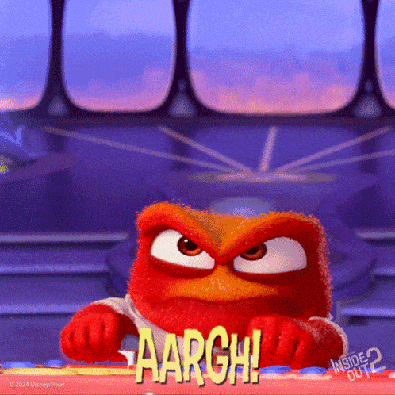
Had experience with this guy?

Slide 4
Why Teach Children SR/A?
SR/A is a critical & core life skill
Anger is a public epidemic & on is the rise
Anger is often a core feature of many neurodevelopmental disorders:
  ASD; ADHD; ODD; IED; & DMDD
We know a lot about anger & self-regulation skills to teach it effectively! But often don’t.

Slide 5
Teaching SR/A Is Not New:
 | Major Modern-Times Milestones
1960’s | Cognitive (Behavioral )Therapy (CBT) introduced - Aaron Beck, M.D. Rational Emotive Behavior Therapy (REBT) - Abert Ellis, Ph.D.
1970’s | Anger Management Training – Raymond Novaco, Ph.D. Sensory Integration and the Child - D.A. Jean Ayers, Ph.D., O.T.
1980’s | Anger Management Programs – upsurge of programs & applications Dialectical Behavior Therapy (DBT) - Marsha Linehan, Ph.D.
1990’s | The Alert Program -Mary Sue Williams & Sherry Schellenberger, OTR/L Social-Emotional Learning (SEL), CASEL – upsurge of programs
2000’s+ | The Incredible 5-Point Scale (2003, 2022) – Keri Dunn Buron, M.Ed. Helping Your Angry Child (2003) – Darlyne Nemeth, Ph.D., et al. Zones of Regulation (2011,2024) – Leah Kuypers, M.Ed., OTR/L Positive Discipline Programs e.g., Conscious Discipline - Becky Bailey, Ph.D.; No Drama Discipline; Dan Siegel, M.D. & Tina Bryson, Ph.D. And Many More

Slide 6
About Anger & its Expression
A natural emotion with an adaptive purpose
Anger is a stress response – Fight/Flight/Freeze continuum
Anger is energy – an e-motion (anger arousal)
Anger is a psycho-physiological experience
Anger may range from mild annoyance to rage
Anger covers many other unpleasant feelings
Anger is contagious – Anger begets anger
Anger can be as addictive as a drug

Slide 7
About Anger & its Expression
Anger ≠ its expression ≠ a character flaw
Anger may be expressed verbally, physically, or internally; & appropriately or inappropriately
Anger may be expressed, suppressed, or vented ; suppression/venting ≠ self-regulation
Unexpressed anger has mental/health impacts
Anger expression is typically episodic & cyclical
SR/A is typically “taught” by punishment for angry misbehaviors, resulting in suppression or venting, which does not contribute to SR/A

Slide 8
What is Self-Regulation of Anger?
A Google AI overview statement:
  "Self-regulation of anger" in children refers to their ability to recognize and manage their own angry feelings, allowing them to respond appropriately to frustrating situations without outbursts or aggressive behavior, essentially calming themselves down when they start to feel angry."

Slide 9
What is a Neurodevelopmental - Systems Approach?
NEURO
  The human brain & nervous system are the source of all thinking, feeling, behaving & relating
  The limbic system & pre-frontal cortex are critical to SR/A
DEVELOPMENTAL
  Orderly progression over one’s lifespan from an immature to mature, adult state; Thru Stages & Critical periods: Other-regulation > Co-regulation > Self-regulation
  The brain & nervous system development follow an orderly progression; 90% brain developed by age 6! Neural “pruning” & new growth happen during tween/teen years
  Psychosocial systems develop concurrently w/ neuro ones; Nature (genetic) x Nurture interact each step of the way

Slide 10
What is a Neurodevelopmental - Systems Approach? cont’d
SYSTEMS
  System = A network of interacting components that operate together to accomplish a functional goal
  Nervous system components: CNS & ANS; Sympathetic & parasympathetic; Exteroceptive & interoceptive, etc.
  Psychosocial systems
    The Caregiver-Child Interactional System is primary
    SR/A skills develop through a Teaching-Learning System
  SR/A: a neurodevelopmental skill set best taught from a neurodevelopmental systems mindset & approach!

Slide 11
SR/A & the Developing Brain
The Emotion Center (Limbic System)
The Executive Center (Pre-Frontal Cortex)
Primitive, survival-oriented, deep structures
Center for e-motion
Immediate/ Short-term
The Alarm Center Fight/Flight/Freeze
The Attachment Center
The Reward Center
The Brain’s DVR - SEL
Most recent, advanced lobe of the human brain
Center for self-discipline
Intermediate/ Future goals
“CEO”/ “Orchestra Conductor” of the brain
Not fully mature until mid-20s!
  ADHD brain – 3 -5 year lag

Slide 12


Caregiver – Child Interaction:
The Classroom of Self-Regulation Learning
Influences:
Neurodevelopmental status
Temperament
Sensory Processing
Physiological state
Stressors
Experience
Relationship
Caregiver Child
SR/A is as much “caught” as it is “taught”

Slide 13

The Anger Cycle {habit}
Resolution
A. Activating event (Trigger)
ANGER
C. Consequence
B. Reaction/
Response

Slide 14
SR/A & Discipline:
What is Positive Discipline?
It is NOT Negative
It is NOT Permissive
Yell/ Scream/ Threaten
Scold/ Reprimand/ Criticize
Lecture/ Nag
Shame/ Blame/ Defame (i.e., name-calling)
Humiliate/ Berate/ Belittle
Spank/ Slap/ Pinch…
Etc.
What about - Time-out? Detention? Behavior Clip Charts?
Being overly lenient, indulgent, laissez-faire
Timid about applying negative consequences
Having few rules, expectations, demands
Giving-in to child’s wishes, aka submissive
Pleading/ Placating
Pampering/ Spoiling
Etc.

Slide 15
What is Positive Discipline?
It IS FIRM & KIND
 | FIRM?
KIND? |  | Yes | No
 | Yes | Positive Do With Child I Win: U Win | Permissive Do For Child I Lose: U Win
 | No | Autocratic Do To Child I Win: U Lose | Disengaged Do Nothing I Lose: U Lose

Slide 16
Positive Discipline vs. Traditional Discipline Mindset
Traditional Discipline
Positive Discipline
Misbehavior major focus
Control/thru Submission
Threaten/ Punish
Episodic
Reactive/ Immediate goal
Overpower
Extrinsic Motivation
Behaving Well focus
Skill/thru Collaboration
Guide/ Nurture
Continuous process
Responsive/ Long-term
Empowerment
Intrinsic Motivation

Slide 17
Positive Discipline:
Dual Developmental Goals
Guide Self-Discipline
Nurture Self-Esteem
Self-Awareness (‘mind mirror’)
Self-Regulation (pause; dial down)
Self-Direction (choose; respond)
Self-Motivation (reward; punish)
Positive Discipline is from the inside out!
Self-Acceptance (“I am loved”)
Self-Worth (“I am valued”)
Self-Confidence (“I am capable”)
Self-Responsibility (“I am accountable”)
“Children do behave well if they can…it is more a matter of skill, than will.” (Ross Greene; J. Stuart Ablon)

Slide 18
Positive Discipline: 4 Principles
Person-Centered
  Child ≠ Misbehavior ≠ Anger; Child is not a miniature adult; Misbehaviors are viewed as “mistaken choices,” not willfulness
Relationship-Based
  Caregiver-child relationship > any episode of misbehavior; Each caregiver-child interaction either ⇑ or ⇓ the relationship; maintains a mutual respect balance of dignity and worth
Skill-Oriented
  Discipline = teaching/learning process; Episodes of behavior = “teachable movements;” Misbehavior communicates a lagging skill, rather than character flaw (irresponsible, willful, not care)
Systematically Applied
  Purposeful; Consistent; w/ Fidelity; Adaptive, not rigid

Slide 19
So, What’s wrong with punishment?
Punishment alone (especially if harsh) does not foster learning to behave well - It often just temporarily suppresses misbehavior in the moment
Often stimulates anger/retaliation or feeling: “I’m a bad person”- diminishing self-esteem
It erodes the caregiver-child relationship that is critical to self-discipline & self-esteem
Fosters an external locus of control rather than the internal locus of control of self-discipline
It teaches escape/ avoidance of the punisher or situation rather than learning self-discipline

Slide 20
Teaching Self-Regulation of Anger:
Tools, Techniques, & Tips
My Calming Procedure
My Roar Rating
My Calming Place & Take5
5-Steps to Taming Temper During & After Episodes
Positive Communication & Conflict Resolution Skills
Notes:
SR/A Teaching Tools & Strategies

Slide 21
Fools give full vent to their anger; but the wise bring calm in the end.
Proverbs 29: 11
Notes:
SR/A Teaching Tools & Strategies

Slide 22






My Calming Procedure
I Close My Eyes
2. I Smile & Sparkle
3. I Breathe-In (slow & deep)
  I Breathe-Out (slow & easy)
4. I Imagine Myself Calm
5. I Say to Myself “I’m Calm”
I am calm!
Notes:
SR/A Teaching Tools & Strategies

Slide 23
My Calming Procedure:
Calm Body Skills
Calm Breathing (aka diaphragmic or belly breathing)
    Inhale through the nose, exhale through the mouth, slowly, deeply, smoothly; w/relaxed shoulders & jaw
    e.g., 4-square breathing; star breathing, etc.
Tense and Release
    Progressively tense then relax body parts from head to toe (or visa versa) to “let it go” (Elsa got it right!)
Body Scan
    Mentally scan & progressively relax body parts head to toe, similar to Tense & Release but only mentally
Notes:
SR/A Teaching Tools & Strategies

Slide 24
My Calming Procedure:
Calm Mind Skills
Positive Self-talk & Affirmations
    Help child to be aware of their automatic negative self-talk that can often increase their anger (e.g., ..)
    Coach child into using positive, calming self-talk affirmations that w/ practice decrease anger (e.g.,…)
Tranquil Imagery
    Visualize a calm place & state of mind & body (e.g.,)
    Coach child to use calm body skills and to engage their senses in the scene to experience “being there”
Notes:
SR/A Teaching Tools & Strategies

Slide 25
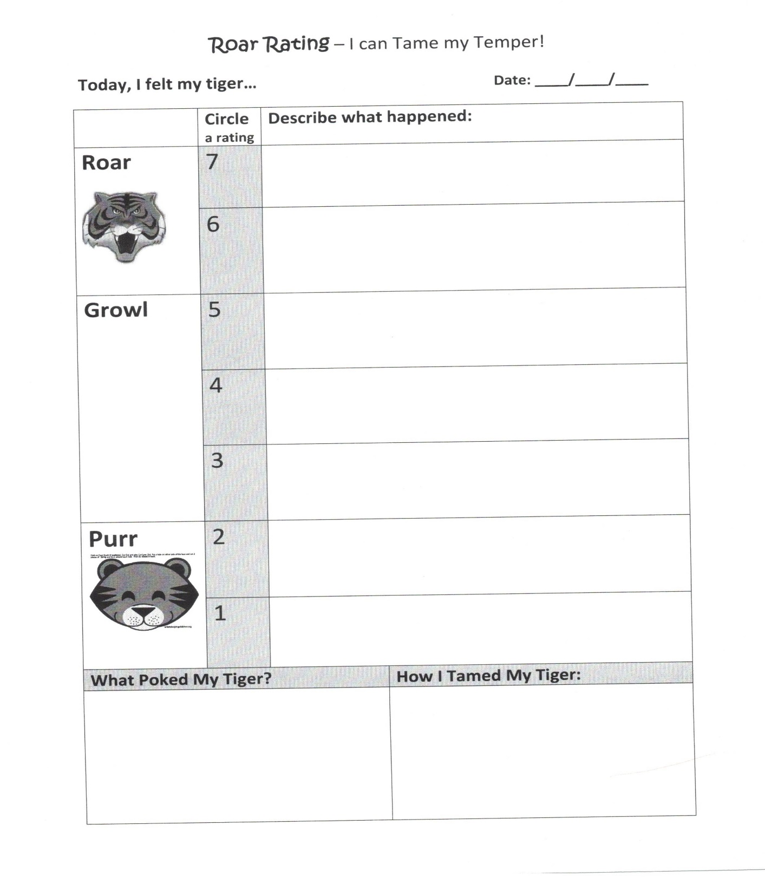

Slide 26
My Roar Rating – More than a scale
A visual guide for a systematic caregiver-child learning dialogue for review of episodes of anger (“temper taming talks”)
Identifies underlying feelings (sensations) & thoughts that triggered (“poked”) anger
Identifies the self-calming skills child used & what may be tried next time to progressively improve SR/A skill
Must be “calibrated” first, anchoring to real-life prior episodes of “roars, growls, purrs”
Notes:
SR/A Teaching Tools & Strategies

Slide 27
Temper the Tiger Tamer Training
A self-regulation of anger therapy program for young children who are challenged by anger & angry outbursts
Anger is metaphorically cast as Temper the Tiger’s roars/growls; Child as a Tiger Tamer
Roar rating is used as a teaching tool
Child is taught specific temper taming techniques to teach Temper to self calm: To growl, rather than roar; To purr more than growl; & celebrating success daily/weekly
Notes:
SR/A Teaching Tools & Strategies

Slide 28
My Calming Place & Take5
An inviting, comfortable place where the child can actively remove her/himself from the anger arousal scene & actively engage in self-calming practices
Pre-equipped with a soft cushion; a calming procedure graphic; books; stuffed animal (Temper the Tiger); sand timer; Personalized by the child; KISS -Not cluttered
This is not a Time Out: Invited use, not demanded use; Also, it’s not a “go to your room and cool down!”
Often used in conjunction w/ Take5: a mutually agreed upon 5-min “break” from the anger arousal moment & place, w/ the expectation of returning afterwards w/ a calmer mindset, to seek solutions together, & maybe even for apologies & forgiveness, etc.
Notes:
SR/A Teaching Tools & Strategies

Slide 29
5-Steps to Taming Temper During & After Episodes
Remain Calm, Connected & Correctional
Empathize & respond in a non-judgmental, validating, empowering manner
Guide & encourage use of a pre-planned self-regulation process
Follow-up with skill learning soon afterwards
Praise & affirm your child (& yourself) for good efforts and accomplishments
Notes:
SR/A Teaching Tools & Strategies

Slide 30
1. Remain Calm, Connected, & Correctional
Caregiver’s self-regulation of own anger is Job#1. Model calm to teach calm. (co-regulation!)
Press “Pause for P.E.A.C.E;” then “slo-mo”
Use your own calm body & calm mind skills
Do a mutual Take5 if anger continues to rise
Keep a correctional mindset, not punitive one: Remember this is a “teachable moment!”
Praise & affirm your child (& yourself) for good efforts and accomplishments of this 1st step!
Notes:
SR/A Teaching Tools & Strategies

Slide 31
2. Empathize & Respond in a Validating & Empowering Way
Empathy & compassion are stronger than anger; Strive to be caring, compassionate, & curious in the moment, rather than critical, accusatory, & coercive
Momentarily assume the child’s perspective (how s/he sees it), & temporarily suspend your own
Acknowledge & validate the mutual anger in the moment, without accepting the misbehavior
Help the child feel heard, felt, understood, & safe
Curious: Wonder & inquire about what is the child’s underlying threat or frustrated need; Reflect upon what skills need to be taught & empower a change
Notes:
SR/A Teaching Tools & Strategies

Slide 32
3. Guide & Encourage Use of a Planned Self-Regulation Process
Meet the child where s/he is & guide SR/A skill
Invite & encourage the child to use a calming procedure; help distract the focus off the anger
At the right moment, encourage use of My Calming Procedure – but don’t force it
Encourage mutual use of Take5 as needed & My Calming Place if anger is on the rise
Praise, encourage & affirm your child (& yourself) for good efforts & accomplishments
Notes:
SR/A Teaching Tools & Strategies

Slide 33
4. Follow-up with SR/A Skill Learning soon after the Episode
Once the episode has subsided, use the Roar Rating tool to identify the intensity of anger, the triggers, the self-regulation skills the child used, & what can be done next time to improve
This as the opportunity to further teach & “tweek” SR/A skills (“temper taming talks”)
Keep the focus on breaking/replacing the cycle
Model mutual respect: Apologies; forgiveness?
Plan for a Check-in (AM)/ Check-out (PM) time
Notes:
SR/A Teaching Tools & Strategies

Slide 34
5. Celebrate Good Efforts & Accomplishments Together!
Acknowledge that this is hard work and takes time, energy, patience, and dedication
Acknowledge the challenges as they arise as opportunities for learning and for creating more celebrations! (a growth mindset!)
Notes:
SR/A Teaching Tools & Strategies

Slide 35
Positive Communication & Conflict Resolution Skills
Seek first to understand, then to be understood
Maintain a mutual respect balance, between caregiver and child
Attack the issue/conflict, not the person
Notes:
SR/A Teaching Tools & Strategies

Slide 36
1. Seek first to understand, then to be understood
Help the child feel heard by seeking first to understand their point of view
Set your own viewpoint aside for a while (“Please help me to understand what is frustrating you right now”)
Listen more than speak (God gave us 2 ears & 1 mouth for a reason!)
Wait patiently for the child to finish before speaking
Notes:
SR/A Teaching Tools & Strategies

Slide 37
2. Maintain a mutual respect balance
Use respectful language, tone, & posture – peaceful, caring vs. threatening, demanding
Use “I messages” & Avoid “U messages” (“I feel angry when you…because…please…”)
Keep the focus on finding a Win-Win solution rather than a Win-Lose solution
Invite mutual problem solving (“What do you think would help next time?”)
Notes:
SR/A Teaching Tools & Strategies

Slide 38
3. Attack the issue, not the child’s personhood
Avoid the shame, blame, or defame game (e.g., “What is wrong with you?!”)
Keep solution-focused rather than fault-finding; & avoid dredging up the past
Use reflective listening – paraphrase what you hear to clarify your interpretation (e.g.)
Celebrate your daily practice of these skills
Notes:
SR/A Teaching Tools & Strategies

Slide 39
Use Collaborative Problem Solving: e.g., Ross Greene’s CPS “Plan B” Approach
1-The Empathy Step
  “I’ve noticed that… [problem is stated respectfully here]” “What’s Up?”
  Reflective listening/clarifying to understand the concern from child’s perspective (listen, be patient & neutral)
2-The Define the Problem Step (or Share Your Concern Step)
  “My concern is...” [caregiver states concern positively]
  State how you see the problem is affecting the child, you &/or others; Continue the collaborative dialogue
3-The Invitation Step
  “I wonder if there’s a way…” [invitation to problem solve]
  Brainstorm with the child, seeking a realistic, mutually satisfactory solution/plan; Then summarize & empower

Slide 40
How to Improve & Maintain A System for Teaching Self-Regulation of Anger
Develop & implement your own personal/ classroom Teaching SR/A Plan
Use the information of this workshop; read books & visit websites; watch YouTube & TED Talks; participate in trainings, etc. There is so much great, free stuff out there!
Invite a friend, spouse or colleague to learn along with you and to be your “accountability partner ” in use of positive teaching practices
PRACTICE SR/A strategies in your everyday interactions & Celebrate Successes Together!

Slide 41
Thanks! Questions?
Thanks so much for your attention and interest throughout today’s presentation!
And best wishes to you on teaching your child, student, or client the critical life skills of self-regulation of anger!
Randall L. Lemoine, Ph.D.
7913 Wrenwood Blvd. Suite A , BRLA, 70808 - 225-383-9808
www.RandallLemoinePhD.com

